Slide 1
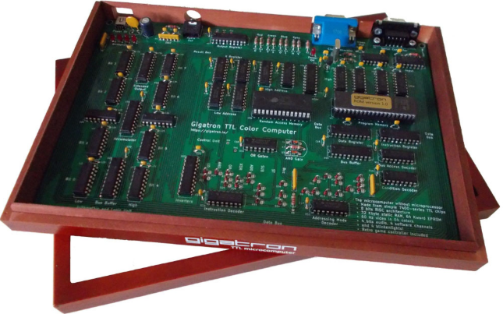
From TTL to Tetris
The Gigatron VGA Colour TTL Computer
A Personal Perspective
Ken Boak
OSHcamp 2019 Hebden Bridge

Slide 2
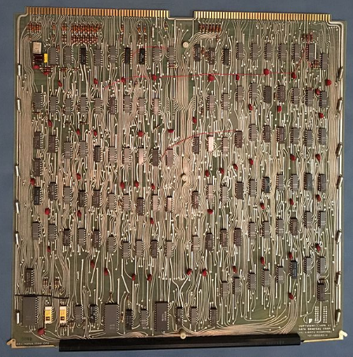
Standard 7400 series TTL was developed in the early 1960’s and by the 1970’s was the standard logic for building minicomputer processors – including the PDP-11, the DG Nova and later models of PDP-8. In 1975 it was still faster and cheaper than the emerging new microprocessors such as the Intel 8080 and the Motorola 6800.
TTL 16-bit CPU board from Data General Nova 1200

Slide 3
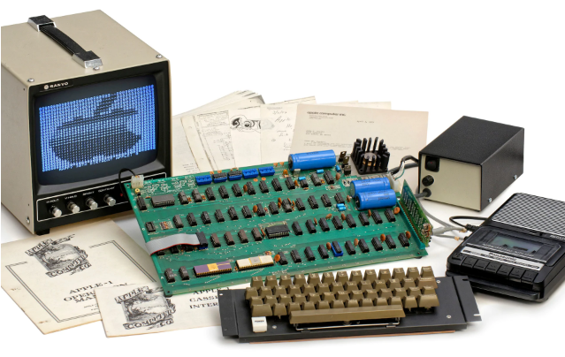
It’s summer 1975, imagine if personal computing history had evolved along a very different path.....
Backstory.
A serious flaw in the logic of the newly developed 6502 means that Chuck Peddle of MOS Technology has to cancel the 6502 product launch at the WesCon75 show....
25 year old Steve Wozniak, unable to afford the $175 Motorola 6800, revisits the simple TTL design he used for his Cream Soda computer.....

Slide 4
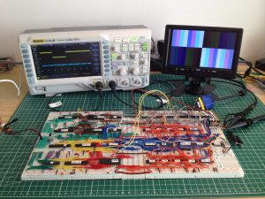
Early Beginnings
The Gigatron began life as 36 TTL chips handwired on a big breadboard.
Marcel van Kervinck prototyped the original on a set of breadboards.
Designed specifically to produce ¼ VGA colour video and sound
Produced as an open source, self build kit – now with over 500 sold
Inspired by the Apple 1 but smaller, cheaper, colourful and faster........

Slide 5
The Hardware Architecture
Built as a Harvard machine with separate ROM and RAM spaces - tailored to generate VGA video from RAM
Consists of the following functional blocks:
ALU Arithmetic Logic Unit
AC Accumulator
PC Program Counter
IR Instruction Register
MAU Memory Address Unit
CU Control Unit
Registers X, Y, In, Out, Data

Slide 6
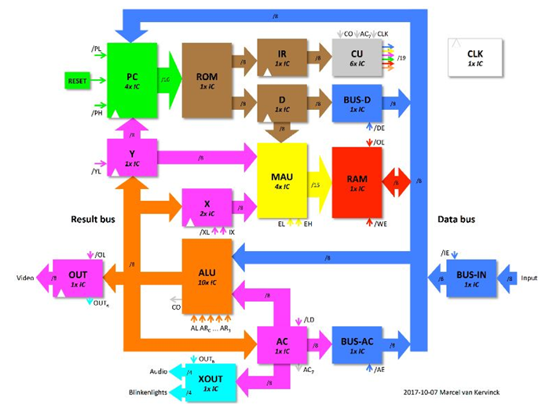
“A processor is like a nest of tangled pythons – all trying to eat each others’ tails.
You have to carefully learn where to start unravelling it all from”

Slide 7
The Gigatron uses only 36 simple TTL devices to implement its Harvard architecture in fewer than 1000 gates.
Dual 4:1 Multiplexers 74xx153
4 bit full adders 74xx283
4-bit counters 74xx161
Octal Latches 74xx377
Various basic gates including OR, AND, Inverters
Serial to parallel shift register for keyboard entry 74HC595
Plus 32K x 8 SRAM and 64K x 16 bit EPROM
With the exception of the EPROM and RAM – all of these parts were available in standard 7400 series TTL in 1975
Average price per 7400 series IC was about $1 each in 1975.
RAM was still very expensive in 1975. 4K bytes implemented as 32 x Intel 2102 SRAMs would cost at least $96. (Byte Magazine October 1975).

Slide 8
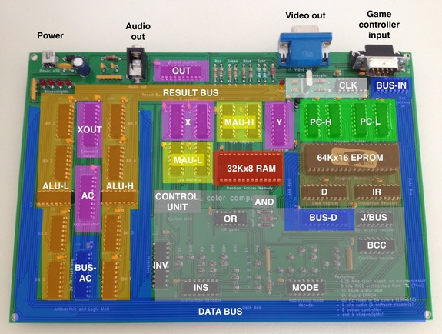
The Gigatron PCB – with principal functions highlighted

Slide 9
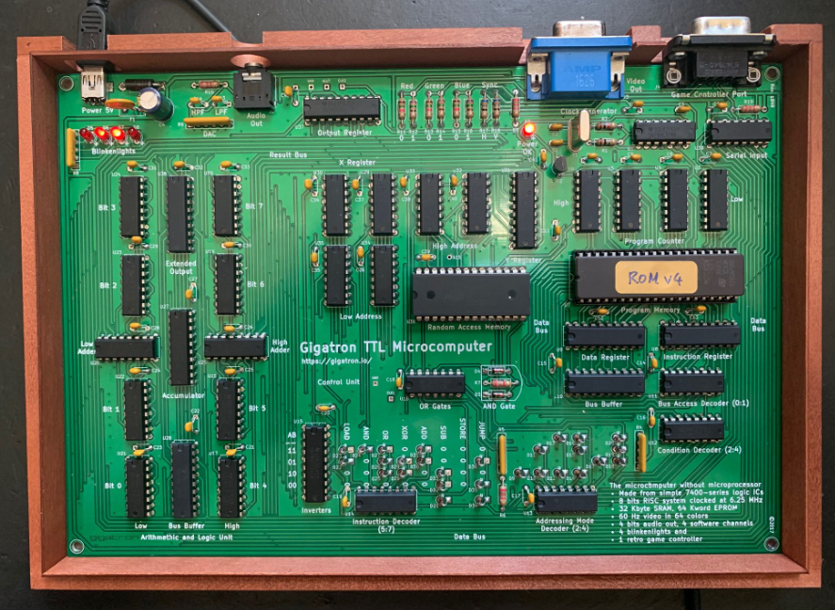
The Gigatron assembled from a kit – on a neat 6“x 9” pcb

Slide 10
The Instruction Set
8-bit wide instruction word providing 8 instructions, 8 addressing modes and 4 data sources for operands.
8 x 8 x 4 = 256 instruction combinations
The Accumulator AC always forms 1 operand of the ALU
Memory load/store LD, ST
Arithmetic ADD, SUB
Logical AND, OR, XOR
Unconditional jumps JMP, BRA
Conditional jumps BGT, BGE, BLT, BLE, BEQ, BNE
Others NOP, CTRL

Slide 11
Instruction Decoding
I7 I6 I5 I4 I3 I2 I1 I0
---Operation--- ---Mode--- ---Bus---
0 LOAD [D],AC D
1 AND [X],AC RAM
2 OR [Y,D],AC AC
3 XOR [Y,X],AC IN
4 ADD [D],X
5 SUB [D],Y
6 STORE [D],OUT
7 JUMP [Y,X++],OUT

Slide 12
The control unit is an example of economical TTL design to provide instruction decoding and overall system coordination.
Decodes the various bitfields of the 8-bit instruction into 19 individual control signals that co-ordinate the operation of the cpu
Generates the bit pattern to drive the ALU using a “diode ROM”
Selects the sources of the various operands according to the instruction and addressing mode
Decodes the conditional branch instruction and generates branch signals to modify the program counter.
Uses 6 TTL ICs, including 3-8 line decoders, multiplexers and basic gates. Plus a 30 diode array to generate ALU and register select signals.

Slide 13
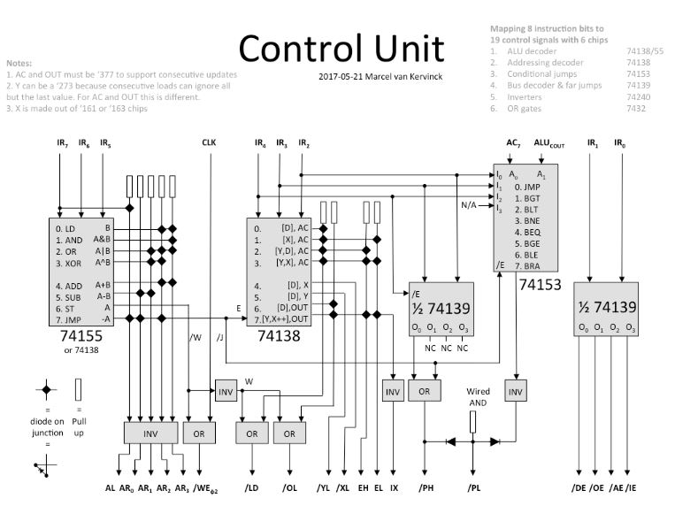

Slide 14
ALU - Arithmetic Logic Unit
The ALU forms the functional core of any processor
Provides 8-bit ADD, SUB arithmetic operations plus bitwise logical operations AND, OR and XOR
Constructed from 10 ICs: 8 x 74HC153 multiplexers and 2 x 74HC283 4-bit adders.
Provides a readily available alternative to the now obsolete and rare 74181 4-bit ALU
Equivalent to approximately 200 logic gates.
All diagrams based on a design by TTL CPU builder Dieter Muller

Slide 15
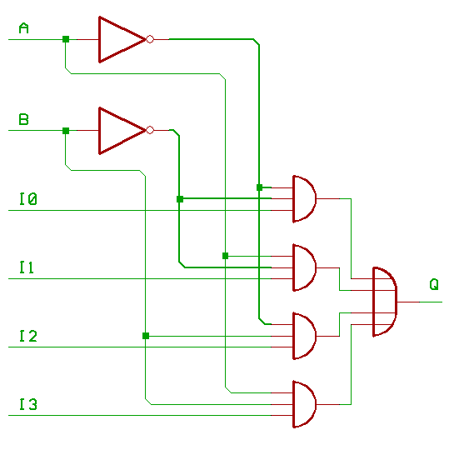
The ALU is based on the 74xx153 dual 4:1 Multiplexer
The 4:1 multiplexer can be used to generate any logic function Q of its two inputs A and B just by wiring various logic 0 or 1 to the inputs I0 to I3.
By feeding a different 4-bit pattern to I0:I3 you can create AND, OR, XOR, invert or any other common logic function of A and B. A programmable function generator.

Slide 16
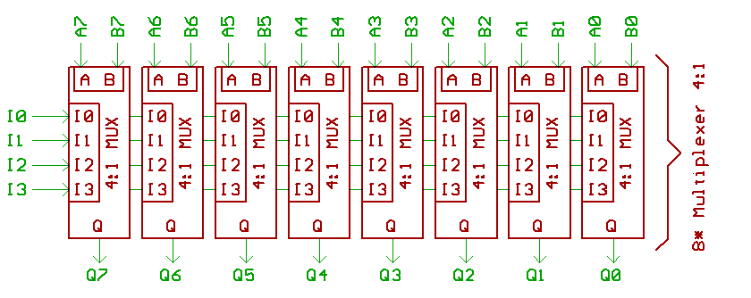
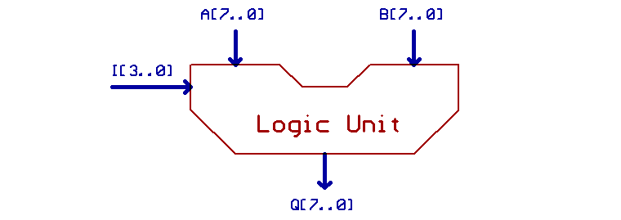
The logic for the ALU is built from 8 such multiplexers, one for each bit:
Applying a 4-bit “instruction” to the I0:I3 inputs allows any one of 16 logic functions, including zero, invert, pass-through etc to be applied bitwise to the 8-bit operands.

Slide 17
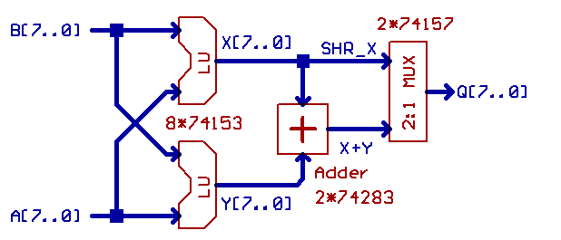
The Arithmetic section is made from two 4-bit adders and two of the 74xx153 logic units.
As the 74xx153 are dual 4:1 multiplexers you conveniently get both logic units from the same 8 ICs!
The two 74xx283 4-bit adders provides 8-bit addition and subtraction.
An optional multiplexer 7xx157 may be added if a Shift Right operation is required. On the Gigatron right shifts are done as a look up table in ROM

Slide 18
The Program Counter and ROM
The Program Counter consists of four, 4-bit presettable counters which generate the 16-bit ROM address.
The counters can be loaded from either the ALU or the data bus to provide the jump address.
The ROM is a 64K x 16bit EPROM. The upper byte contains the instruction and the lower byte contains data, constants or a branch address.
The Gigatron employs a very simple pipelined architecture – such that one instruction is being executed whilst the next instruction is being fetched. This permits a throughput of 1 instruction per clock cycle – which at 6.25MHz allows pixels to be pushed to the VGA port.

Slide 19
RAM, X and Y Registers and Video Generation Hardware
From the outset, the Gigatron was designed to output a 64 colour image to a VGA display.
The resolution is 160 by 120 pixels - effectively ¼ VGA
The X and Y registers address a 32K RAM – and effectively hold the horizontal and vertical location of the pixel.
The X register is an 8-bit counter which can auto-increment to select the next pixel in the line of video.
The video RAM holds the RGB video (2 bits of each) and the remaining 2 bits are for the horizontal and vertical sync signals.
The video signal is created using a simple resistor network DAC.

Slide 20
Software Highlights
What the Gigatron lacks in hardware it makes up for in software!
Whilst the native hardware is an 8-bit Harvard architecture running code from ROM, Marcel has implemented a 16-bit virtual cpu (vCPU) with a Von Neumann architecture executing code from RAM.
vCPU executes 16-bit instructions which are precisely timed to fit in with the video generation timing.
There is an online emulator, an assembler and other tools written in Python.
Gigatron comes with TinyBASIC in ROM and a hex monitor program inspired by WozMon – originally written for the Apple 1 by Steve Wozniak

Slide 21
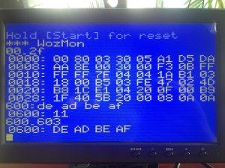
WozMon – in 254 bytes!

Slide 22
What’s New?
Gigatron is a constantly evolving project with an active community and many new developments since the original machine.
“Pluggy McPlugface” – an adaptor that allows a PS/2 keyboard to be used
A C compiler based on lcc – write standard code using modern tools.
v6502 allows the Gigatron to emulate the 6502 – with video at about 0.125MHz - but gives access to a wealth of software such as Microchess.
A RAM and port expansion board that allows use of SPI hardware such as SD cards, port expanders and FRAM non-volatile memory.
By using 74F series logic, Gigatron can be overclocked to 12.5MHz – twice the standard clock frequency.

Slide 23
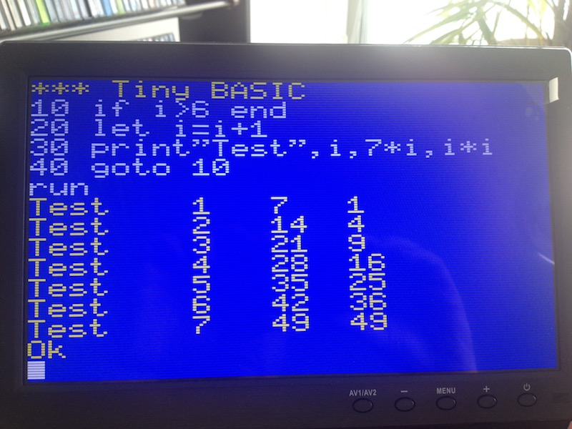
TinyBASIC

Slide 24
Final Thoughts
Gigatron is an anachronism – but it could have been an evolutionary path in1975 – if microprocessors had not emerged at that time. It is faster and cheaper than those first generation microprocessors.
TTL is still very much available even 50 years after its first introduction. With fast, high density ROMs and SRAM a machine like Gigatron can be produced.
Studying a design like Gigatron gives a unique insight into what makes a cpu work. Those lessons can be reapplied to modern logic – such as creating soft cores from FPGAs.
A lot can be achieved with clever digital design and very little else.
A workshop session is planned for tomorrow.
Meet Marcel van Kervinck in person next weekend at the Cambridge Centre for Computing History.

Slide 25
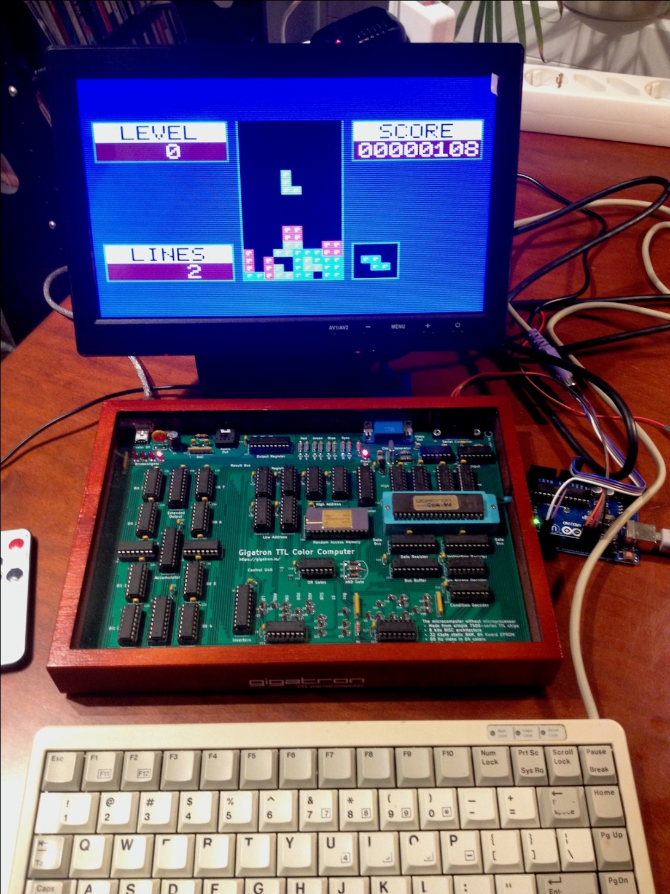
And Finally..... Tetris

